Slide 1
Ferns Identification

Slide 2
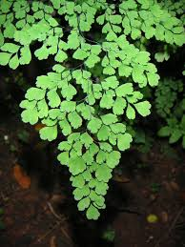

Slide 3
1: Adiantum spp- Maidenhair Fern

Slide 4
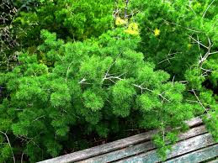

Slide 5
9: Asparagus Densiflorus ‘Myriocladus’- Ming Fern

Slide 6
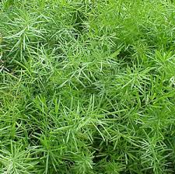

Slide 7
10: Asparagus Densiflorus ‘Sprengeri’- Sprengeri Fern

Slide 8
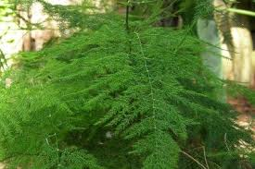

Slide 9
11: Asparagus Setaceus- Plumosa Fern

Slide 10
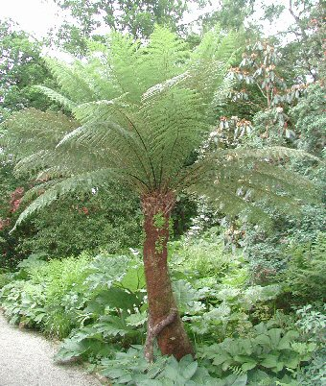

Slide 11
12: Asparagus Setaceus ‘Pyramidalis’- Tree Fern

Slide 12
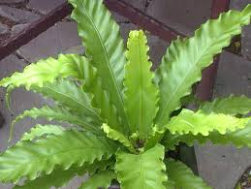

Slide 13
13: Asplenium Nidus- Bird’s Nest Fern

Slide 14
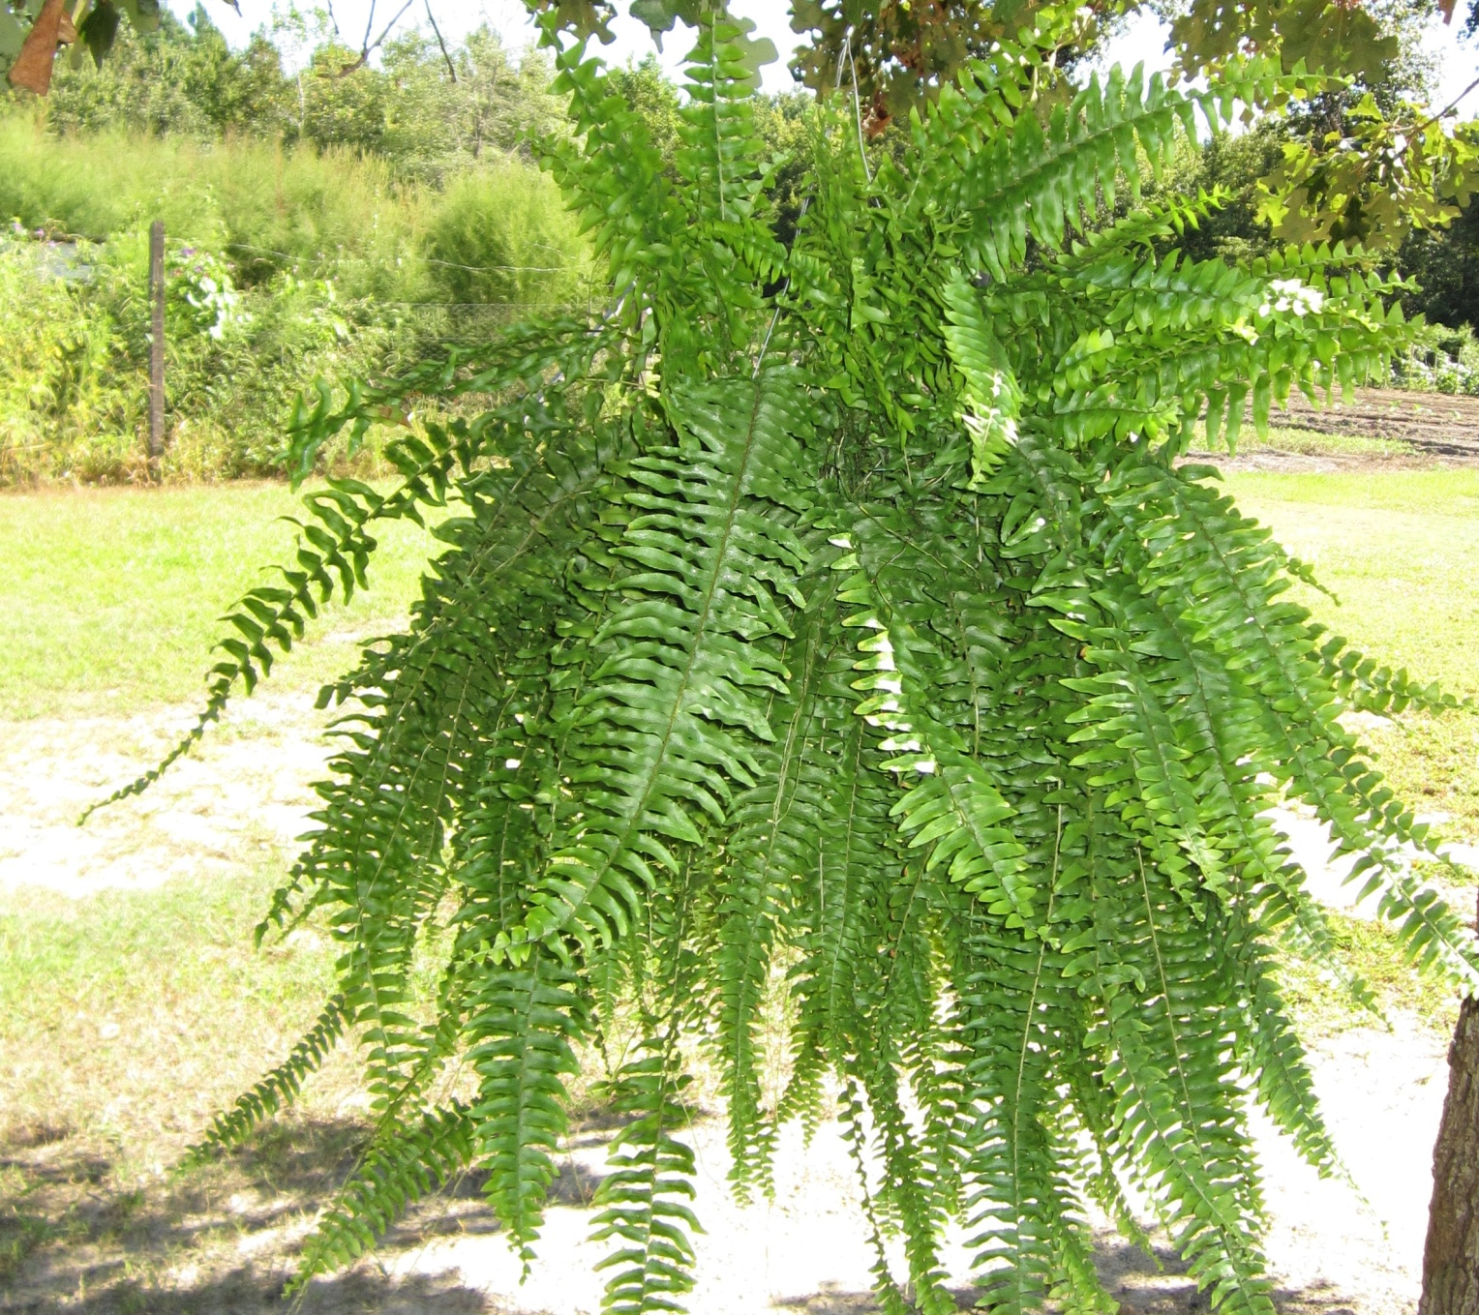

Slide 15
79: Nephrolepis Exaltata Cv.- Boston Fern

Slide 16
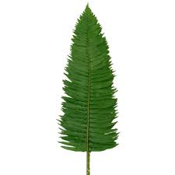

Slide 17
80: Nephrolepis Cordifolia Cv.- Flat Fern

Slide 18
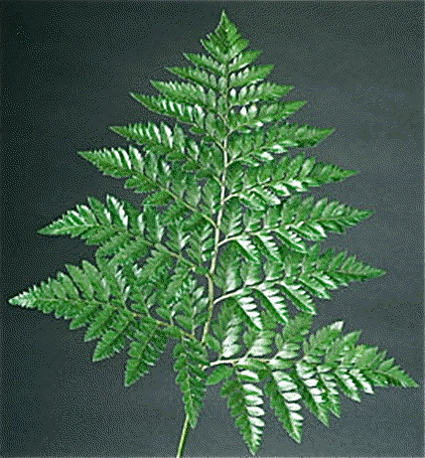

Slide 19
94: Rumohra Adiantiforms- Leatherleaf Fern

